Slide 1
HOTEL BOOKING PREDICTION
USING UNSUPERVISED LEARNING TECHNIQUES

Slide 2
OBJECTIVE
The main objective of this project is to predict and recommend Three hotel clusters to a user that he/she is more likely to book in given hundred distinct clusters.

Slide 3
TABLE OF CONTENTS
Introduction
Importing necessary LIBRARIES
Data Preprocessing
EDA
Data Visualisation
Applying Machine learning Technique
Conclusion

Slide 4
METHODOLOGY
In Unsupervised Machine Learning, many clustering algorithms are used to
group objects for analysis and finding patterns.One commonly known technique
is Agglomerative Clustering, where objects that are close to each other are placed
in one group.In the beginning, all objects are single clusters (leaves) and the algorithm
keeps on clustering objects until a single cluster (root) remains. Clustering forms a tree
like structure called a dendrogram.

Slide 5
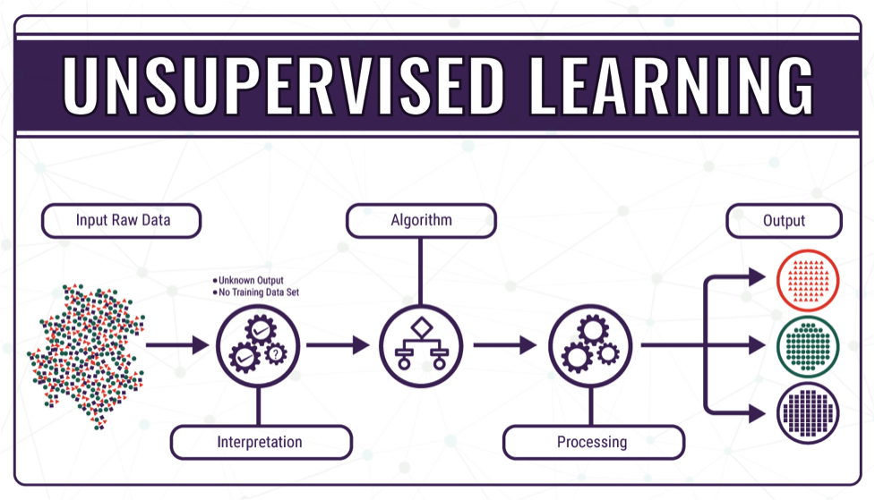
WORKFLOW

Slide 6
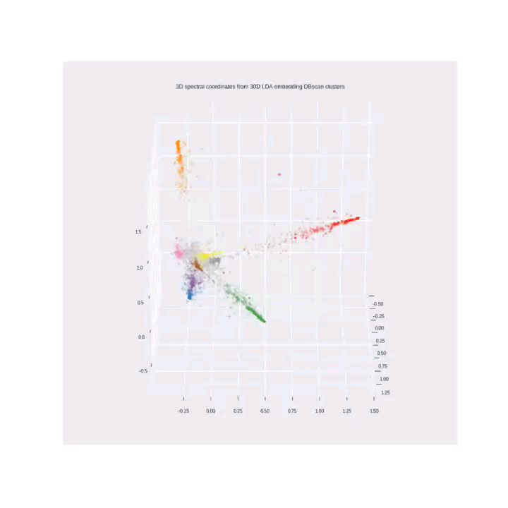
Conclusion
Thus from the above technique we
Conclude that the top rated hotel is
“Holiday Home Green Resort Mooi
Bemelen-19” and the rest of hotels
have been sorted accordingly.

